Slide 1


Introducing RAEbot
RESPONSIVE ASSISTANCE TO THE ELDERLY
RHYNA SUSSANA JOHN

Slide 2

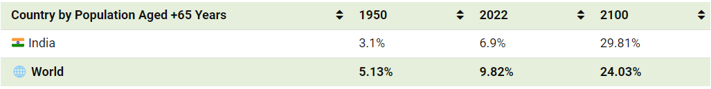
10%
Elderly population Across Globe
In 2022, there were 771 million people aged 65+ years globally, accounting for almost 10% of the world’s population.

Slide 3
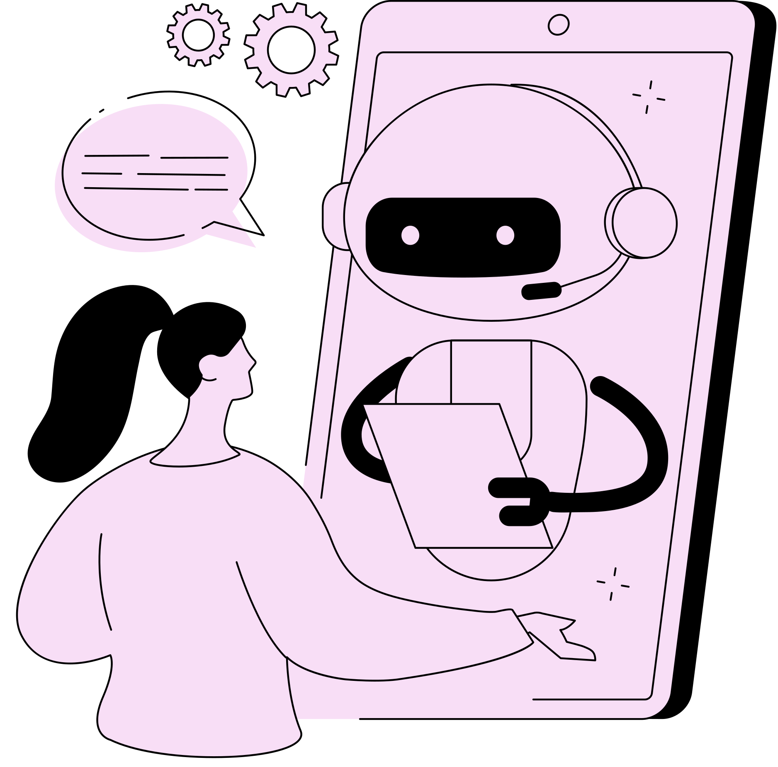
Why RAEBOT?
Responsive Assistance
Empathetic Virtual Companion
Comprehensive Support
Integration of Technology and Empathy for a Comprehensive Solution to serve Humanity

Slide 4


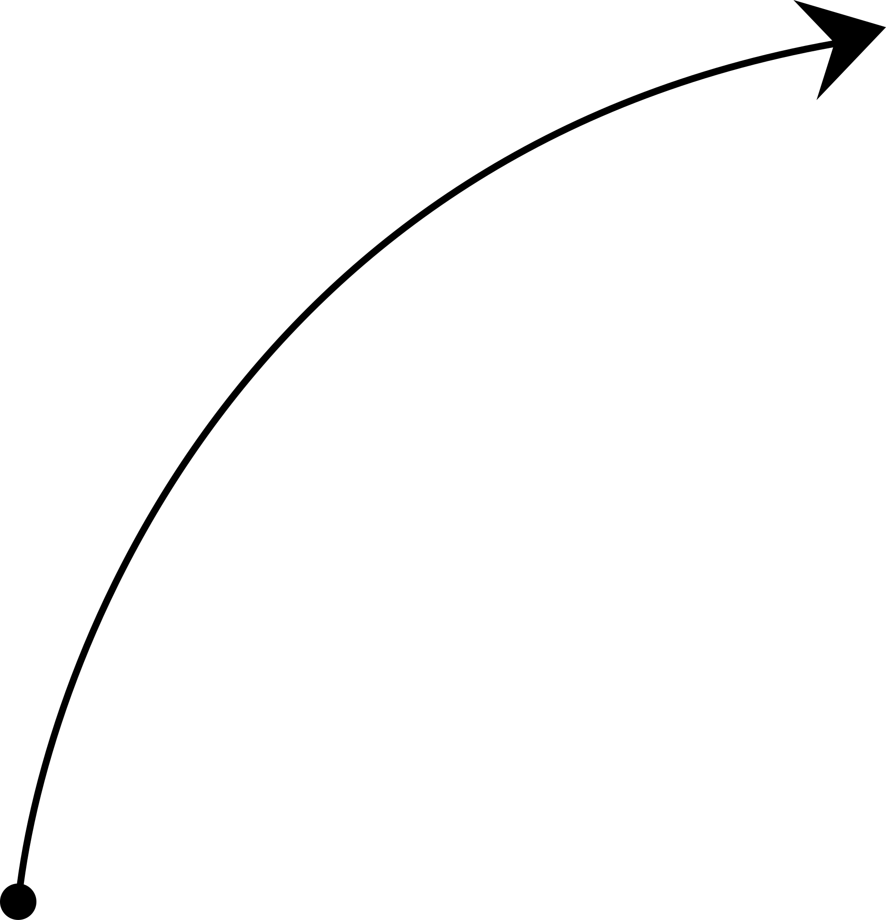
Cutting-edge solution designed to cater to the unique needs of seniors.
RAEbot is not just a machine; it's a responsive and empathetic virtual companion meticulously designed to comprehensively address the diverse needs of the elderly.
RAEbot seamlessly integrates state-of-the-art artificial intelligence (AI) technology with a profoundly human-centric approach.
One of RAEbot's notable features is its ability to communicate through spoken responses, providing a more natural and user-friendly interaction for seniors.
From this
To this

Slide 5

Social Interaction and Mental Health
Financial Security
Health and Medication Management
Holistic Wellbeing
RAEbot Objectives
Comprehensive Support for diverse elderly challenges
Access to Healthcare
Safety and Abuse Prevention
Increase Efficiency in Information Retrieval
Mobility Enhancement
Nutritional Wellbeing

Slide 6
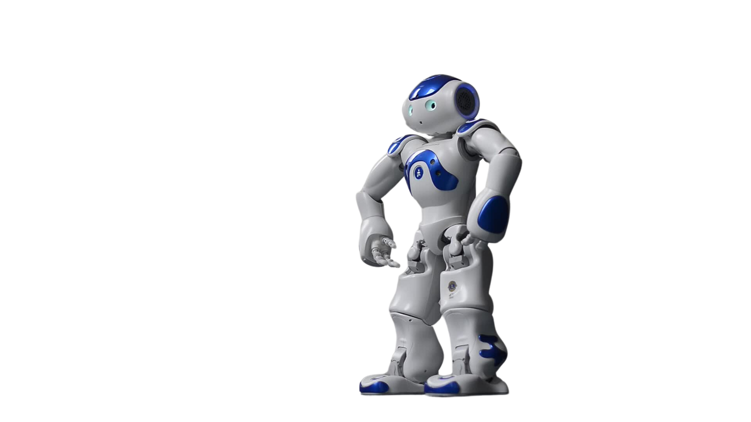
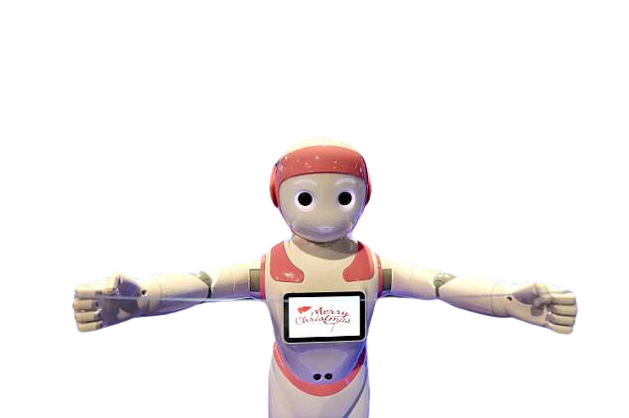
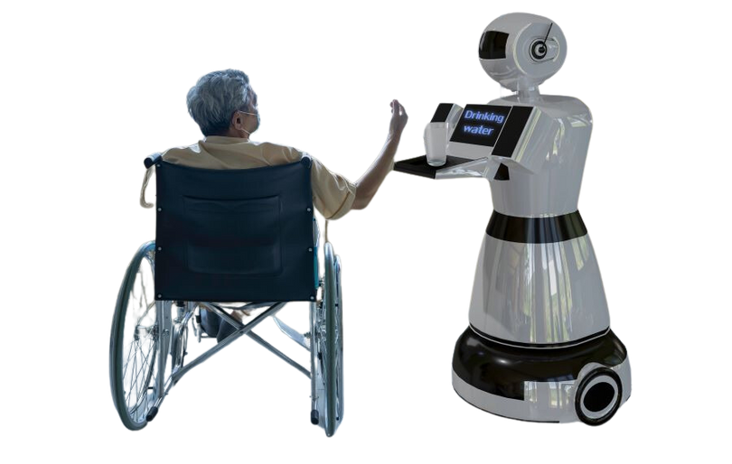
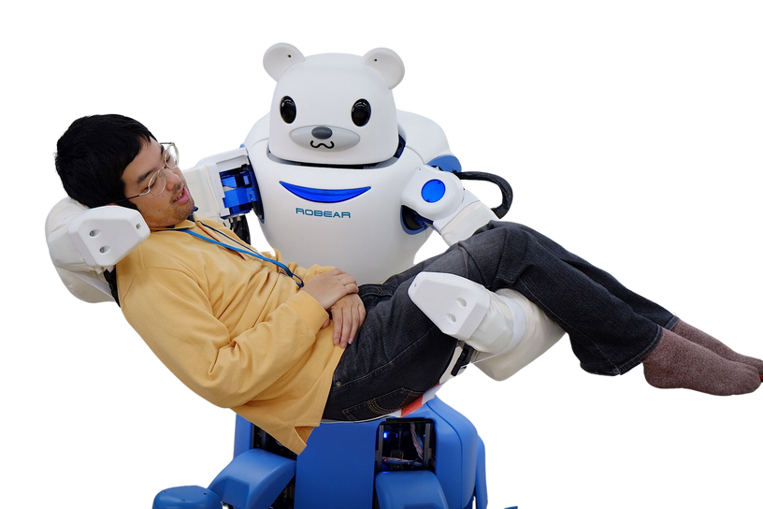
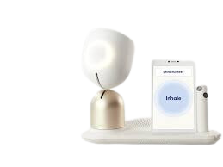
Existing technology
Several existing technologies, such as ElliQ, ROBEAR, SAM, Zora, and iPal, have been developed to assist the elderly in various capacities.
Why Are these Existing Technologies not fit for the Demography?
Physical Intrusiveness
High Development Costs
Limited AffordabilityTechnological Intimidation
Cultural Sensitivity and Acceptance
Dependency Concerns
Privacy Concerns
ZORA
ELLIQ
ROBEAR
IPAL
SAM

Slide 7


FLOW OF ACTION
RAEbot's architecture is built upon two pivotal components: model.py and ingest.py. These components work seamlessly together to create a sophisticated and responsive system.
User Input
Query Handling
Utilizing Cutting-edge Technology
Retrieval QA Chain
Spoken Responses
User Session Management
Iterative Conversation
Final Answer Retrieval
User Interaction
Langchain Callback Handler

Slide 8

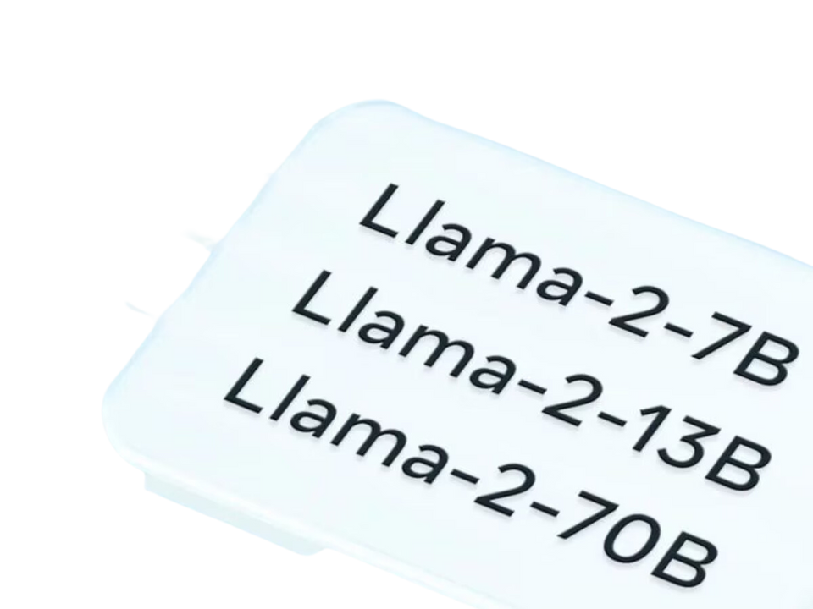
Technologies Used:
Programming Language: Python
NLP Models: TheBloke/Llama-2-7B-Chat-GGML, sentence-transformers/all-MiniLM-L6-v2
Vector Storage: FAISS
Libraries and Frameworks: pyttsx3, speech_recognition, langchain, chainlit
Hardware Requirements
In the production phase it is highly dependent on the internet connection and stability

Slide 9
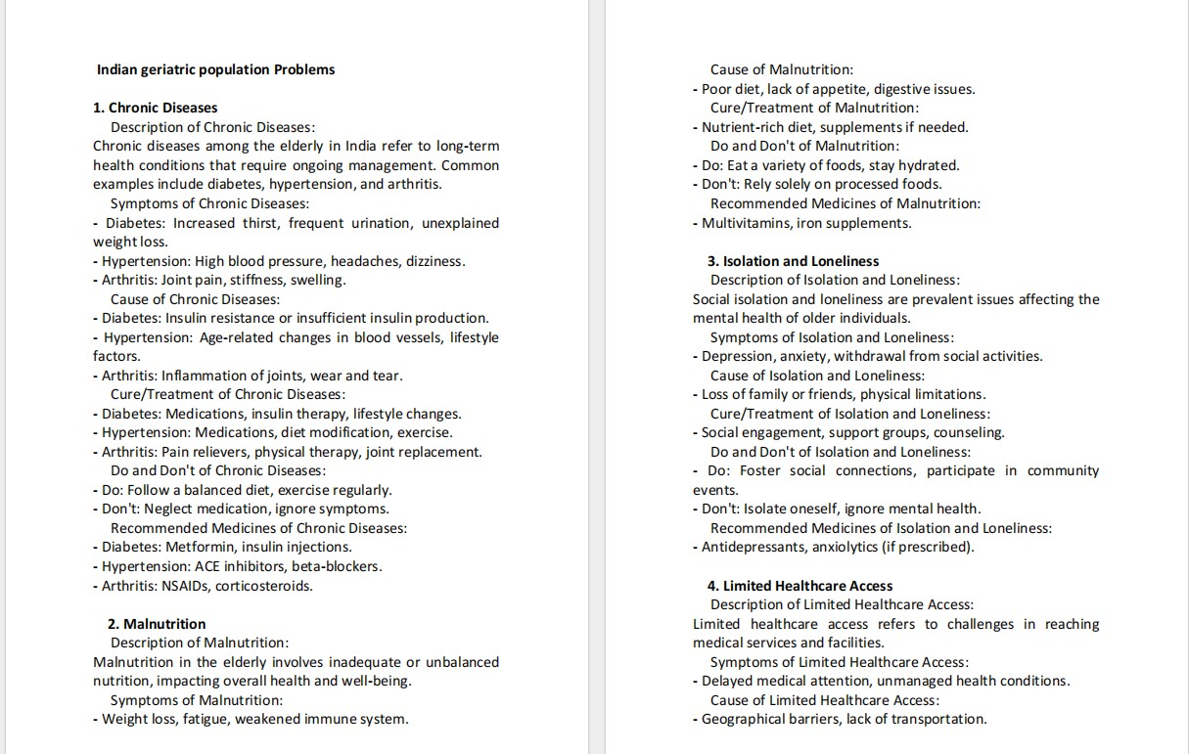
Sample of Data set

Slide 10
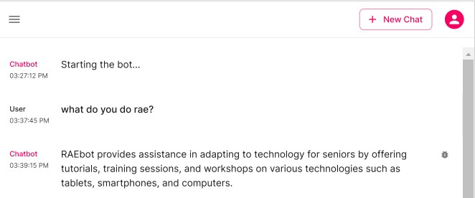
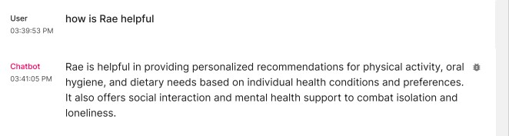
Snapshot of a conversation

Slide 11
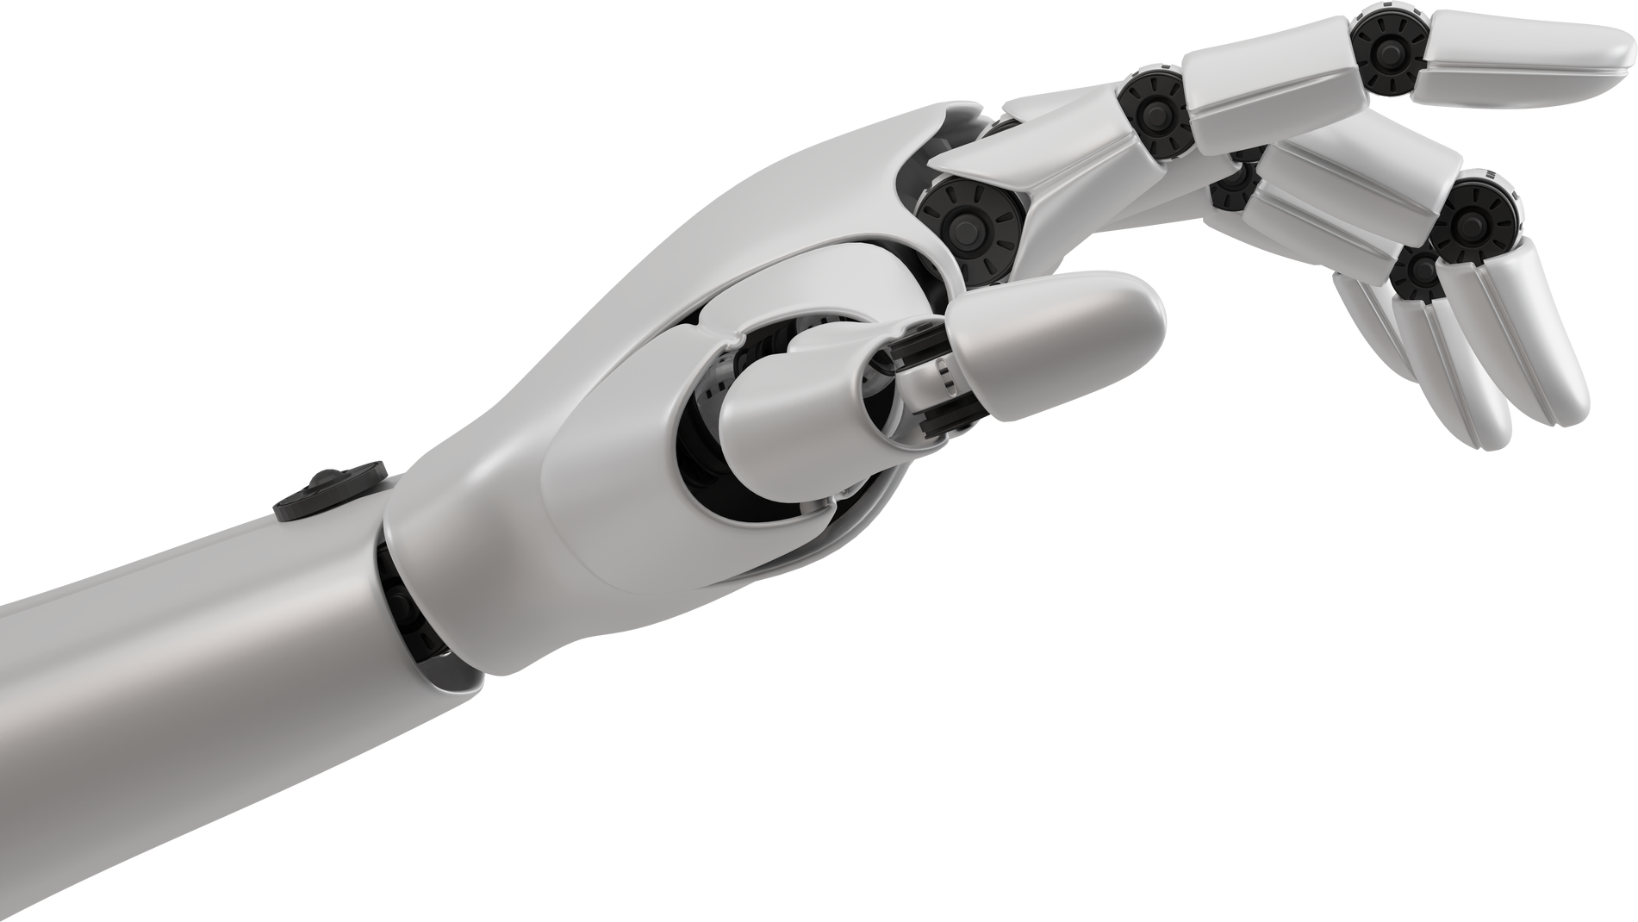
FUTURE VISION FOR RAEBOT
Multilingual Support
Domain-Specific Adaptation
Interactive Learning
Enhanced Speech Interaction

Slide 12
Thank You
For choosing RAEbot as your responsive elderly assistant.

Slide 13
Thank You
For choosing RAEbot as your responsive elderly assistant.

